Slide 1
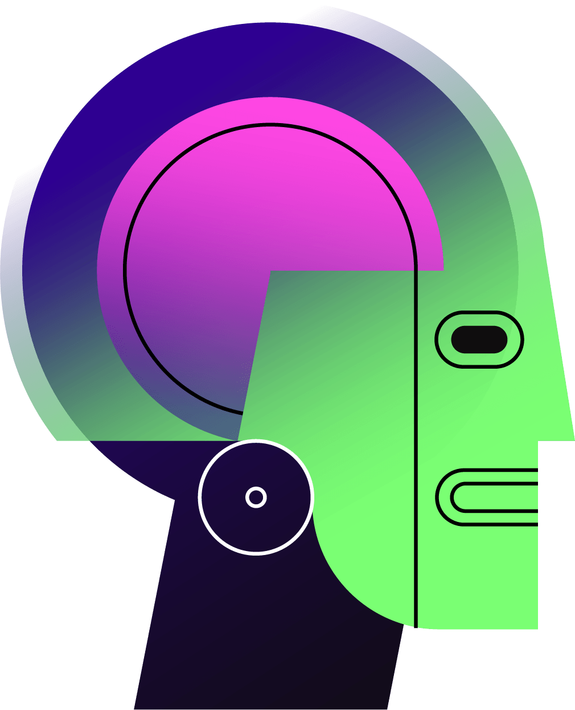
An AI-Powered Assistant
ULTRON
Government Polytechnic Athani

Slide 2

01
02
03
Table of contents
04
05
06
Introduction
Overview
Block diagram
Working principle.
Its advantage & disadvantages
Future Work
Government Polytechnic Athani

Slide 3
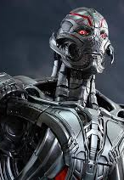
01
Introduction
Government Polytechnic Athani

Slide 4
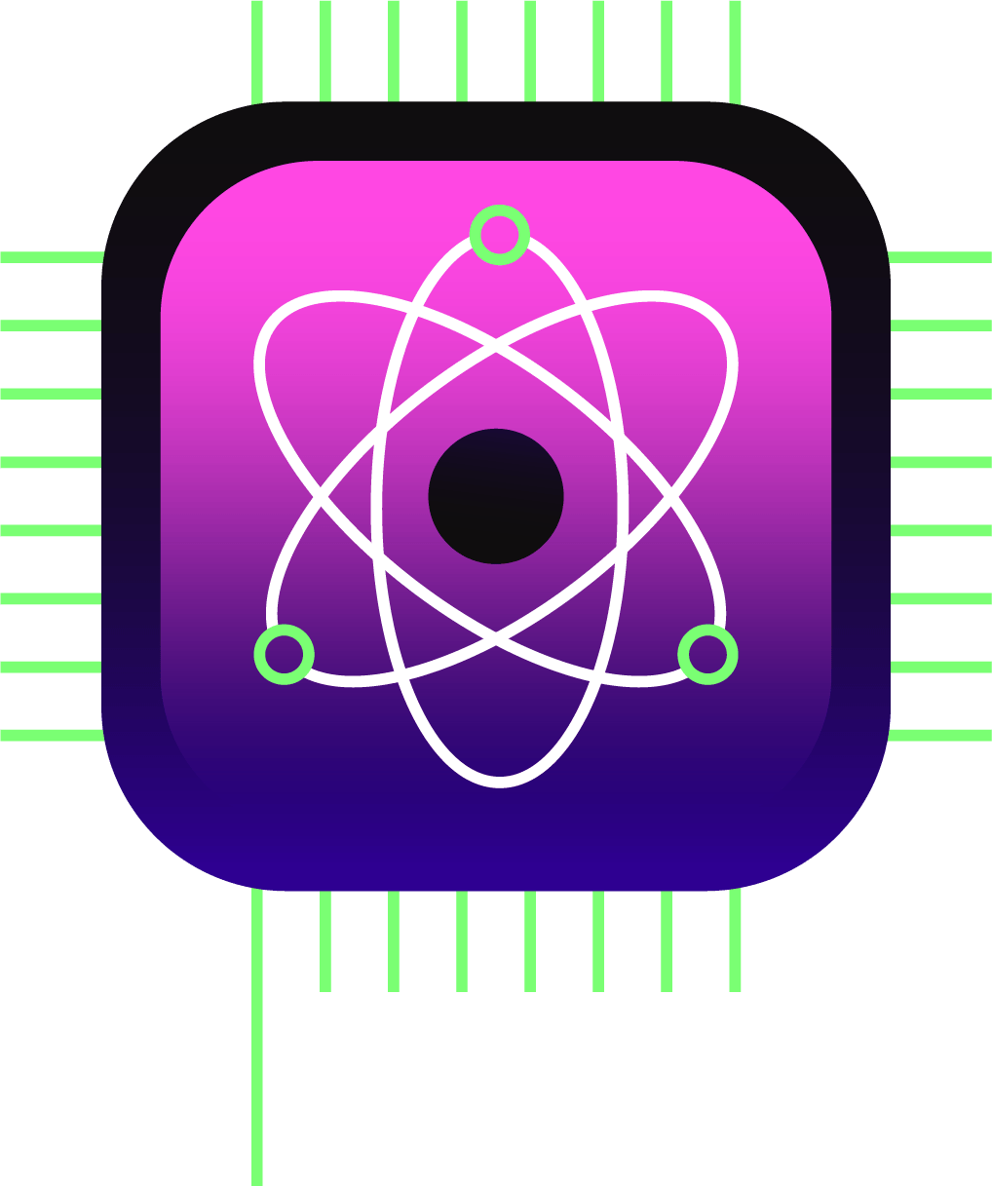
Introduction
Ultron:
A versatile AI assistant capable of performing
various tasks through voice commands.
Ultron is a Python-based AI assistant designed to enhance user productivity and convenience by translating speech to text and text to speech
Ultron can execute a wide range of tasks using voice commands, making it a versatile and interactive tool.
Ultron represents a step forward in AI-powered personal assistants, providing a blend of speech recognition, task execution, and natural language understanding to create a seamless and interactive user experience.
Government Polytechnic Athani

Slide 5
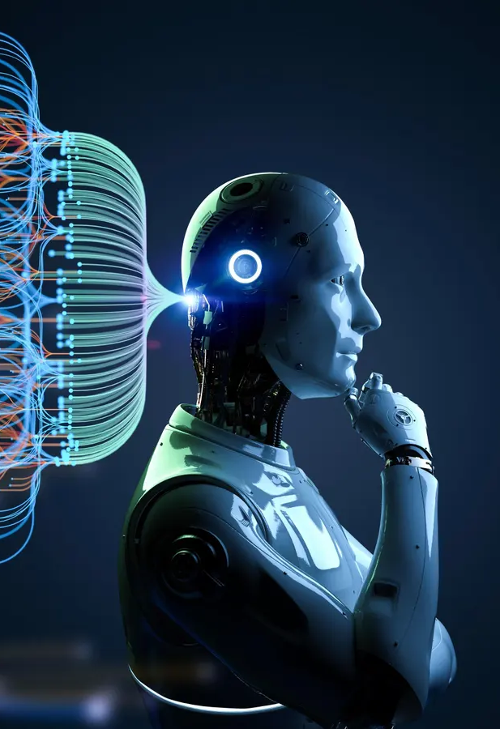
02
Overview
Government Polytechnic Athani

Slide 6
Key Features and Capabilities
Speech Recognition:
Text to Speech:
Utilizes the “speech_recognition” library to convert spoken language into text.
Uses the pyttsx3 library to convert text back into spoken language.
Personalized Greetings:
Task Execution:
Greets the user based on the time of day (morning, afternoon, or evening).
Can search Wikipedia, play music, open web pages, and capture photos.
Government Polytechnic Athani

Slide 7
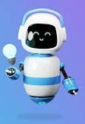
03
Block Diagram
Government Polytechnic Athani

Slide 8





Block Diagram
Wikipedia Search:
Opening Websites
Playing Music
Telling Time
Print Response
Txt-to-speech
start
Speech recognition
Speech-to txt
Commands
Opening Applications
Searching the Web
Taking Photos
Thank you
END
Large Language Model (LLM)
Government Polytechnic Athani

Slide 9
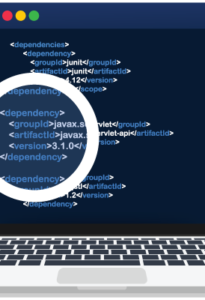
04
Working Principle
Government Polytechnic Athani

Slide 10
Working Principles
Initialization
Sets up the recognizer and the text-to-speech engine.
Prepares Ultron to listen and respond to user commands.
Command
Processing:
Response Generation:
Uses Llama-2 to generate natural language responses.
Provides spoken responses using text-to-speech.
Listens for voice commands and converts them into text using the microphone.
Processes the text to identify and execute the appropriate task.
Government Polytechnic Athani

Slide 11
Tasks and Commands
Play Music
Wikipedia Search
Open Websites:
Search Wikipedia for [topic]"
Ultron retrieves a brief summary from Wikipedia and reads it out loud.
"Open YouTube"
"Open Google"
Ultron opens the specified website in a web browser.
"Play music" or "Play song"
Ultron plays a random song from a predefined directory.
Time Inquiry
Application Launch
Photo Capture
"Open VS Code"
Ultron launches Visual Studio Code.
"Take a photo"
Ultron captures an image using the computer's camera.
"What is the time now?"
Ultron provides the current time.
Government Polytechnic Athani

Slide 12
Large Language Model (LLM)
It is a type of artificial intelligence (AI) program that can recognize and generate text, among other tasks.
Replicate
Replicate makes it easy to run machine learning models in the cloud from open source llms.
Llama 2
open source, free for research and commercial use
Llama 2 was pretrained on publicly available
online data sources.
Government Polytechnic Athani

Slide 13
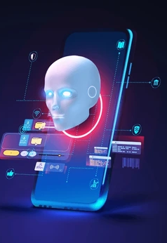
05
Advantages & Disadvantages
Government Polytechnic Athani

Slide 14
Advantages
Disadvantages
Hands-Free Operation
Accessibility
Convenience
Versatility
Accuracy
Noise Sensitivity
Dependency on Internet
Limited by Predefined
Commands
Government Polytechnic Athani

Slide 15
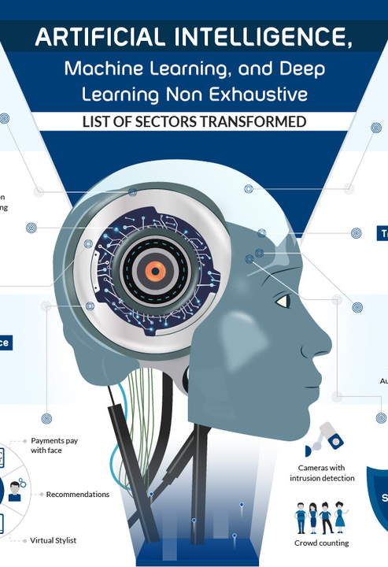
06
Future work
Government Polytechnic Athani

Slide 16

Future Works
Design Interface
Accuracy of speech recognition
Add new future tasks
Increase response Speed
Un necessary Noise reduction
Run LLM on local machine
Adding new Task for Automation
Government Polytechnic Athani

Slide 17

Thanks!
Presented by,
Samarth Koli
Chandrakant Nemagoud
Government Polytechnic Athani

